Slide 1
Breast Cancer prediction using machine learning
capstone PROJECT

Slide 2
TEAM - 12
18K41A0545 - R. MALAVIKA
18K41A0577 - G. VARSHITH
18K41A0587 - K. MOUNIKA
18K41A05C4 – A. SAI SRIJA
GUIDE :
Dr. D. KOTHANDARAMAN

Slide 3
Problem Statement
Cancer is a critical disease from many years. This leads to death if it is not diagnosed at early stage.
Computer Science & Engineering is used in Bioinformatics and Biomedical to diagnose and prognoses disease Cancer. This can be further directed to a field called Machine Learning where various techniques are available to predict the cancer on the basis of collected standard data sets.
We need to apply some classifiers of Machine Learning Techniques to signify the cancer in a human.
In this, we have used different algorithms to compare the accuracy of different algorithm of Machine Learning about cancer depending on the given data sets.

Slide 4
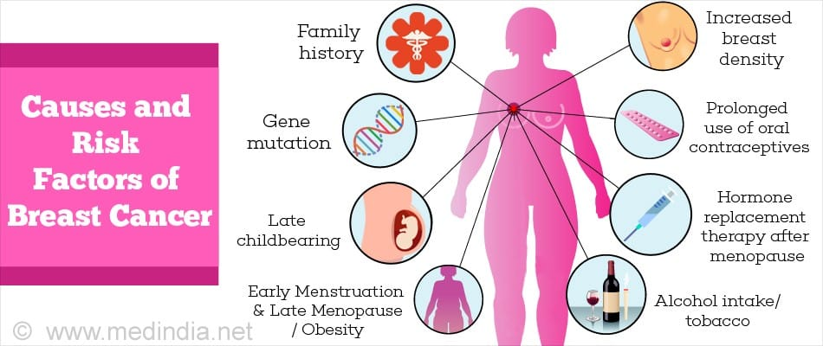
Abstract
In the current generation, Cancer has became the common disease. Among all the types of cancer, Breast cancer is more. Each year number of deaths is increasing extremely because of breast cancer.
It is the most frequent type of all cancers and the major cause of death in women.
Any development for prediction and diagnosis of cancer disease is capital important for a healthy life.

Slide 5
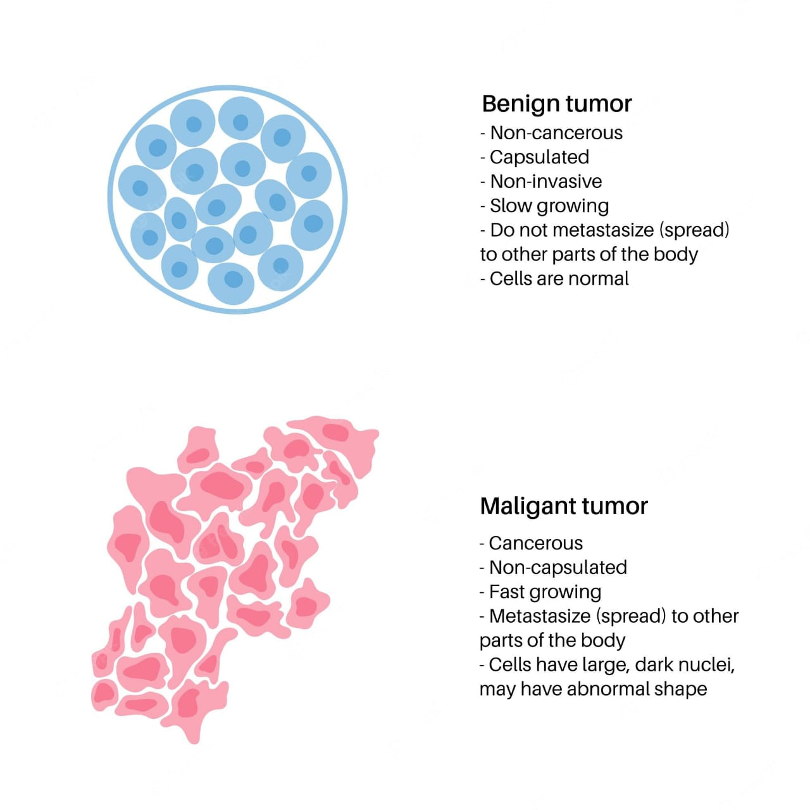
Introduction
Basically, there are two types in breast cancer. They are malignant and benign.
Types of breast cancer:
Malignant
Benign
The main objective of this project to build the model for predicting cancer using various machine learning techniques and predicting the chances of reoccurrence of cancer.

Slide 6
Literature Survey
Author name | Proposed method | Demerits
Wang, D. Zhang and Y. H. Huang | Logistic Regression | -> Slow process
B. Akbugday | KNN | ->Requires high memory and expensive

Slide 7
Author name | Method | Merits and Demerits
Keles, M. Kaya | Random Forest | -> Requires more time for training
V. Chaurasia and S. Pal | Naive Bayes | -> This algorithm is a lousy estimator so you shouldn’t take the probability output too seriously.

Slide 8
Author name | Method | Demerits
R. K. Kavitha1, D. D. Rangasamy | Neural Networks | ->Statistical distribution of input keeps changing as training proceeds.
P. Sinthia, R. Devi, S. Gayathri and R. Sivasankari | backpropagation method | ->Sensitive to complex data.

Slide 9
Software and Languages
Python
ML algorithms
Google Colab

Slide 10
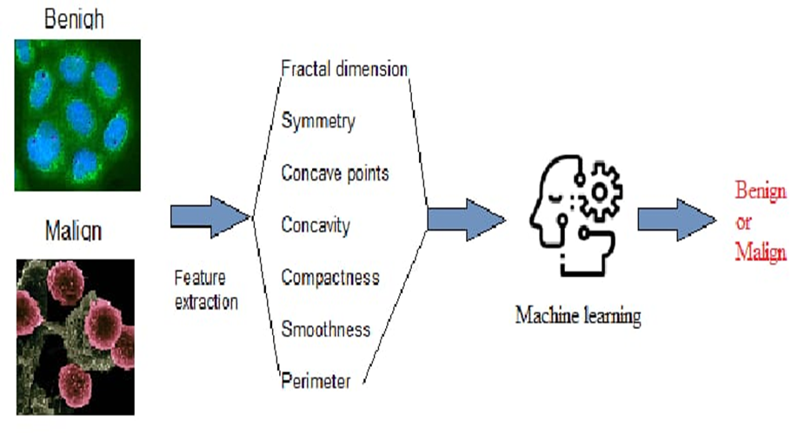
DESIGN METHODOLOGY
As an approach to our model, our idea is to predict through machine learning algorithms resulting in best accuracy.
In the implementation phase we have followed these steps:
Importing Data
Data Pre-processing
Training and Testing data
Prediction

Slide 11
Algorithms Used
Logistic Regression
Decision Tree
Naive Bayes
K Nearest Neighbors
Support Vector Machine
Random Forest
Each method has its own merits and disadvantages. In order to get the best results, we applied prediction techniques to all these algorithms and analyzed the different results obtained by different classifiers.

Slide 12
FLOWCHART
Dataset
Training data
Logistic regression
Decision Tree
Pre-processing
Naïve bayes
Feature extraction
KNN
SVM
ML Algorithms
Test data
Model
Result

Slide 13
Dataset
We are using dataset from Kaggle website.
https://www.kaggle.com/buddhiniw/breast-cancer-prediction/data

Slide 14
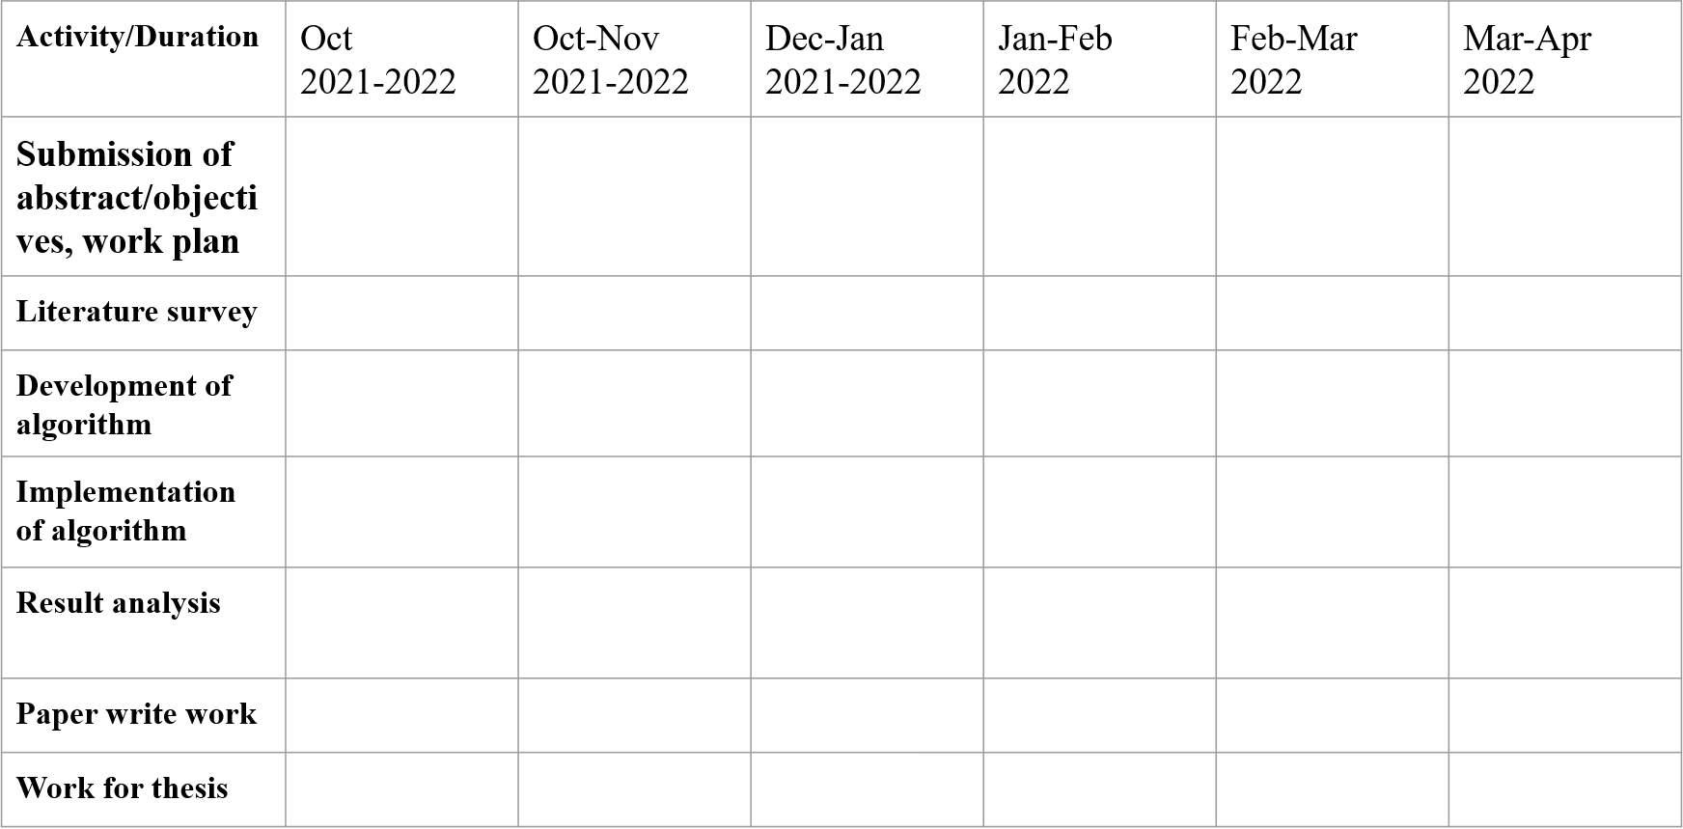
Project Planning

Slide 15
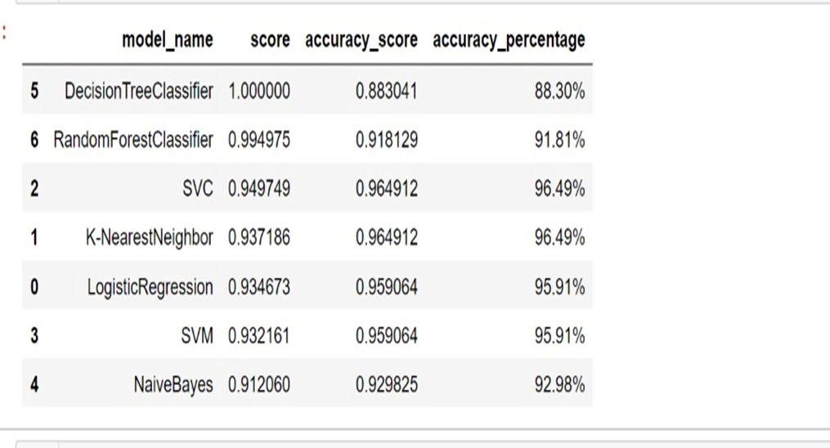
Result
Score and accuracy for all the algorithms

Slide 16
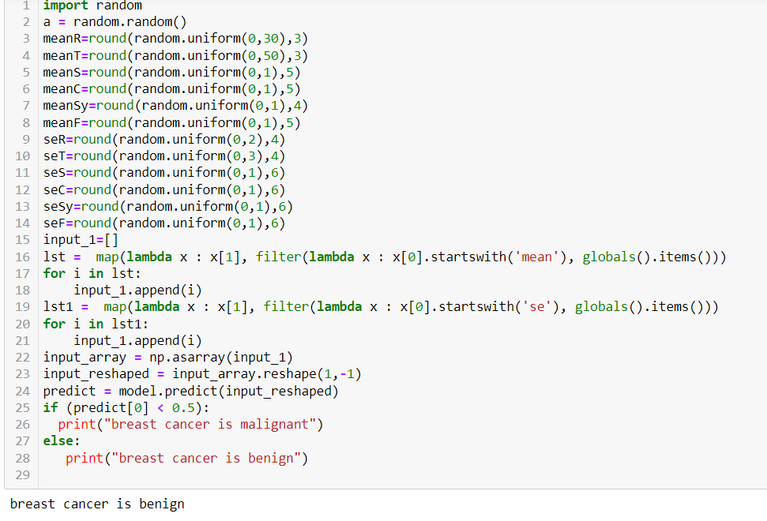
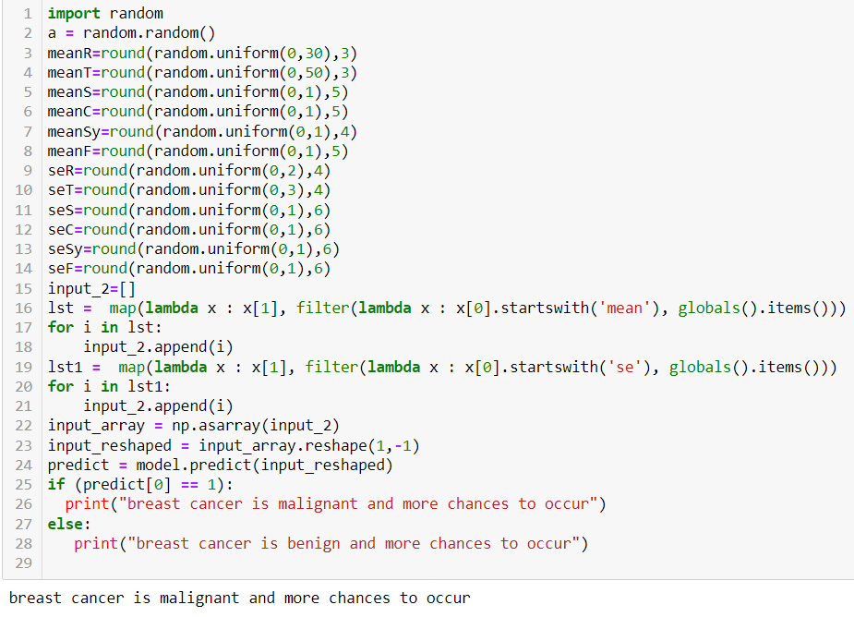
Among all the algorithms SVM has the highest score of 96% and lowest has decision tree with 88%.
The prediction for breast cancer and reoccurrence of best cancer are :

Slide 17
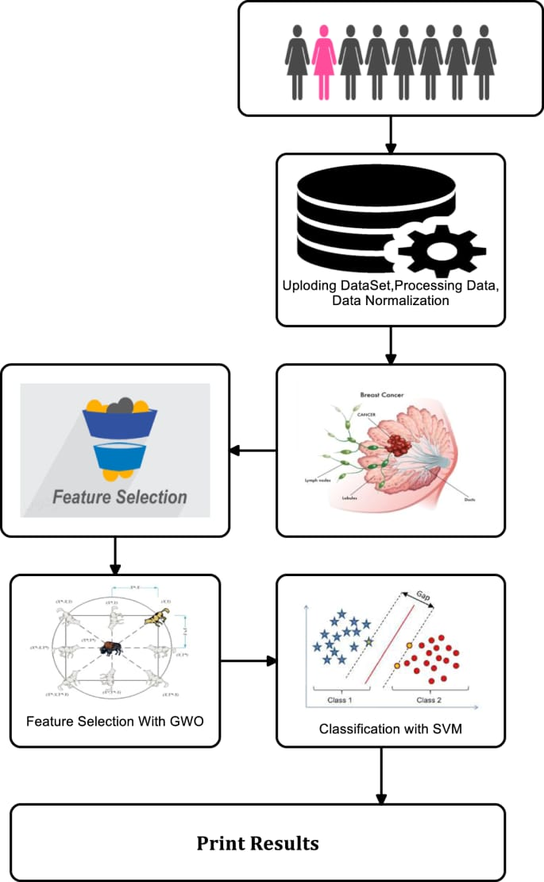
The figure describes the process of breast cancer prediction using SVM
Classifer.

Slide 18
Conclusion:
Breast cancer is considered to be one of the significant causes of death in women. So , early detection of breast cancer plays an essential role to save women’s life.
Breast cancer detection can be done with the help of modern machine learning algorithms.
Machine Learning models are getting better than pathologists at accurately predicting the development of cancer.
We are intending how to parametrize our classification techniques to achieve high accuracy. We are looking into many datasets and how further Machine Learning algorithms can be used to characterize Breast Cancer. We want to reduce the error rates with maximum accuracy.

Slide 19
References
Wang, D. Zhang and Y. H. Huang “Breast Cancer Prediction Using Machine Learning” (2018), Vol. 66, NO. 7.
B. Akbugday, "Classification of Breast Cancer Data Using Machine Learning Algorithms," 2019 Medical Technologies Congress (TIPTEKNO), Izmir, Turkey, 2019, pp. 1-4.
Keles, M. Kaya, "Breast Cancer Prediction and Detection Using Data Mining Classification Algorithms: A Comparative Study." Tehnicki Vjesnik - Technical Gazette, vol. 26, no. 1, 2019, p. 149+. [4] V. Chaurasia and S. Pal, “Data Mining Techniques: To Predict and Resolve Breast Cancer Survivability”, IJCSMC, Vol. 3, Issue. 1, January 2014, pg.10 – 22.
Delen, D.; Walker, G.; Kadam, A. Predicting breast cancer survivability: A comparison of three data mining methods. Artif. Intell. Med. 2005, 34, 113–127.
R. K. Kavitha1, D. D. Rangasamy, “Breast Cancer Survivability Using Adaptive Voting Ensemble Machine Learning Algorithm Adaboost and CART Algorithm” Volume 3, Special Issue 1, February 2014 [7] P. Sinthia, R. Devi, S. Gayathri and R. Sivasankari, “Breast Cancer detection using PCPCET and ADEWNN”, CIEEE’ 17, p.63-65

Slide 20
THANK YOU

